Slide 1
Reliability of the cadastre in a digital world
Martin Salzmann
Cadastre, Land Registry and Mapping Agency
The Netherlands
PCC Conference Legal reliability of the Cadastre
Vienna, Austria, November 20-21,2018

Slide 2
Real estate transaction chain in the Netherlands
CITIZENS (buyer, seller)
Interme-
diaries
Banks
Notaries
Kadaster
land registry
cadastral surveying
cadastral registration
Valuators
Real Estate Agencies
focus
System highly reliable
and trusted
Inland Revenue
Reliability of the cadastre in a digital world

Slide 3
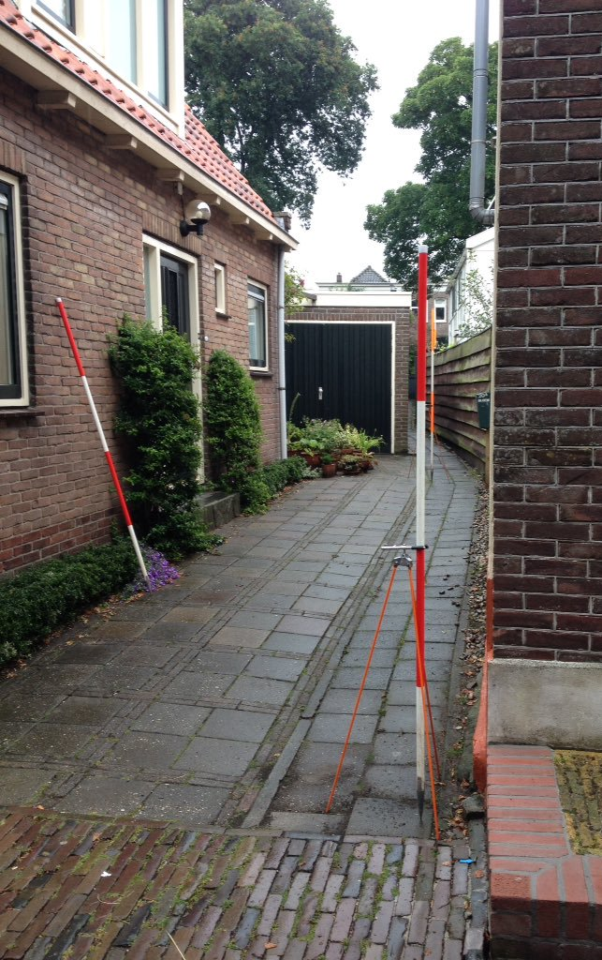
Parallel worlds
Institutional world
Real world
Administrative world
Reliability of the cadastre in a digital world

Slide 4
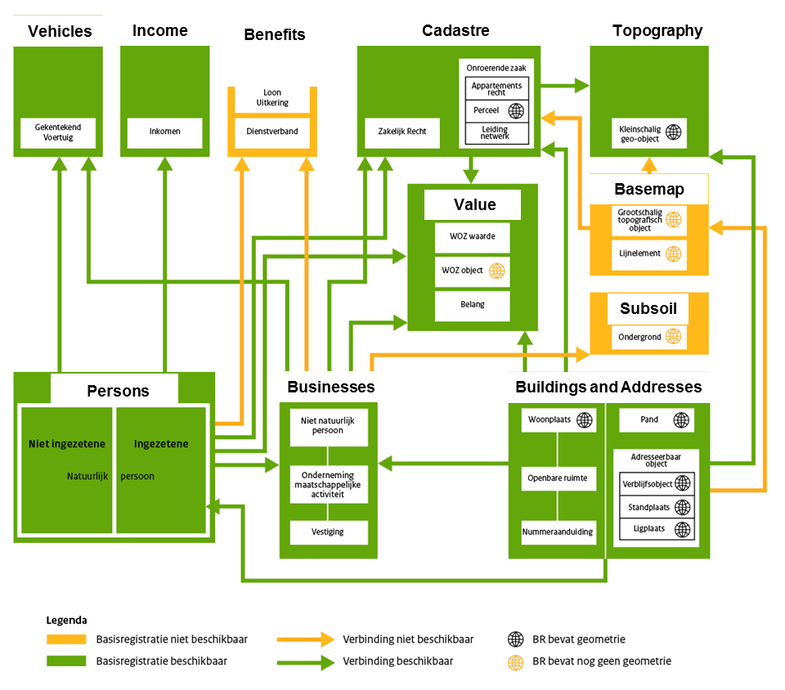
System of key registers in the Netherlands administrative world
Vehicles
Income
Benefits
Cadastre
Topography
Base map
Valuation
Subsurface
Persons
Businesses
Buildings and Adresses
Reliability of the Cadastre

Slide 5
Legal Reliability Cadastre (NL-case)
No
but often registration mandatory and consequences of non registration
Institutional world
Real world
No
but high level of trust in cadastre function
Administrative world
Yes
mandatory use and assumption of correctness
Reliability of the cadastre in a digital world

Slide 6
Data driven society
From the world of quality management
“In God we trust; all others need to bring data”
Quote of W. Edwards Deming
To the world of digital society
Reliability of the cadastre in a digital world

Slide 7
Relations between the different worlds
life event
rules
institutional fact
causes
results in
institutional event
compliancy
administrative event
ensures
results in
actor
processes
data
Source: Best practices for meaningful connected computing (www.bp4mc2.org)
Reliability of the cadastre in a digital world

Slide 8
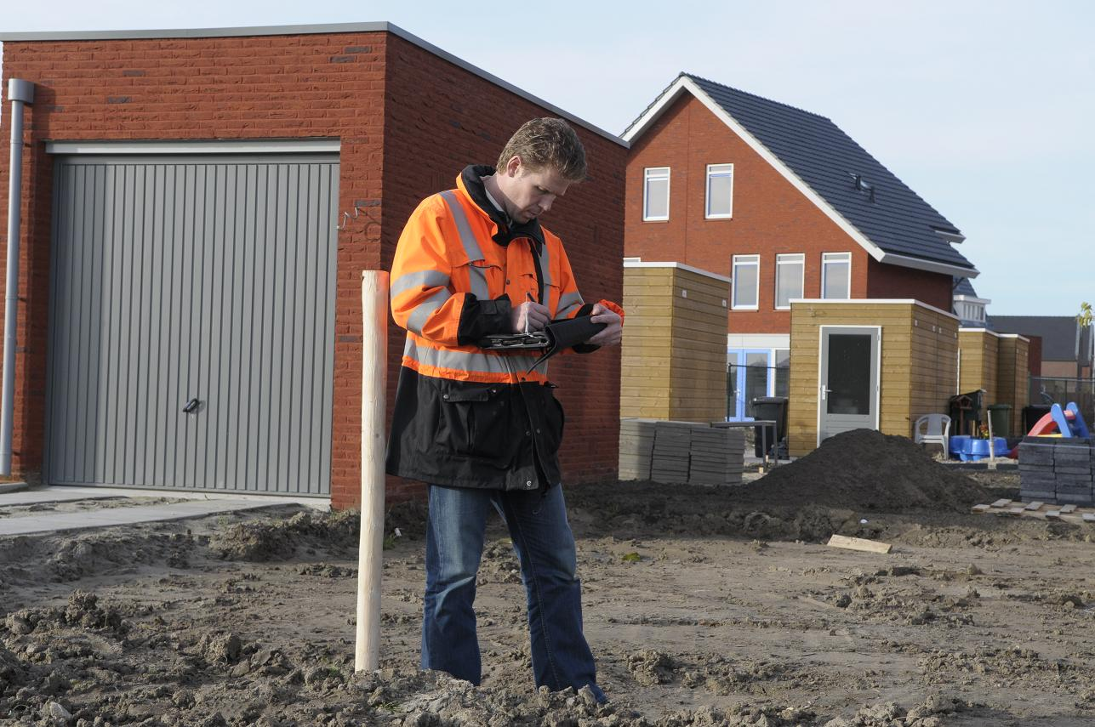
Cadastral Surveying and Mapping

Slide 9
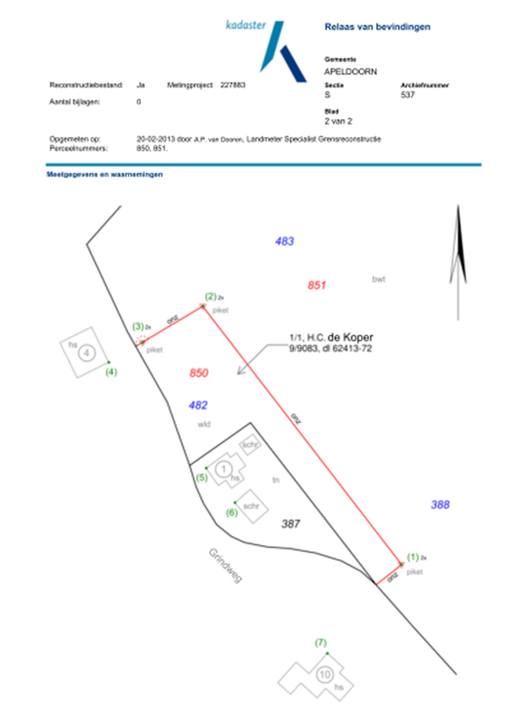
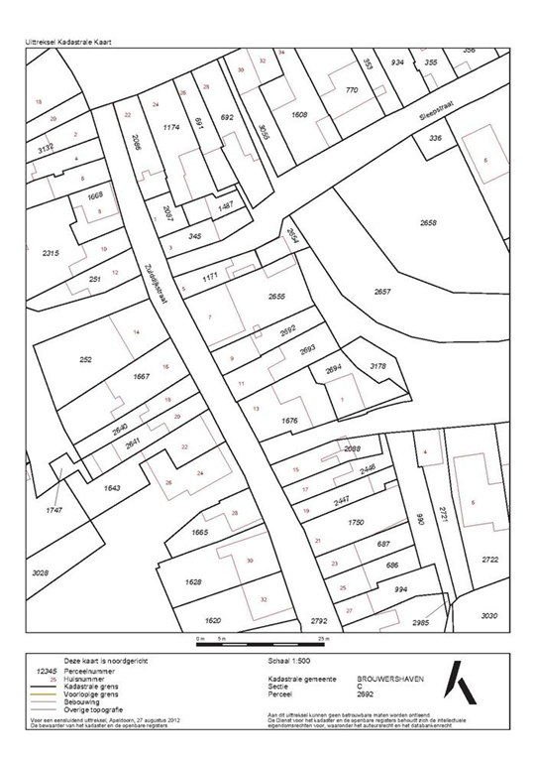
Cadastral (index) map and boundaries
Cadastral map
Nationwide coverage
Since 1832
Digital since end of nineties
Cadastral boundaries
Archived from ± 1880
Measurements on field sheets
80.000 boundary measurements
Reliability of the cadastre in a digital world

Slide 10
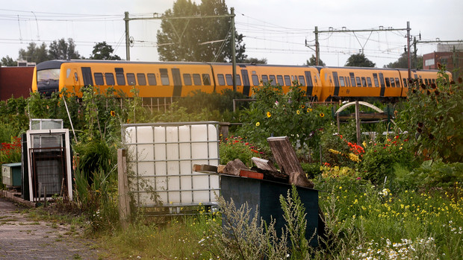
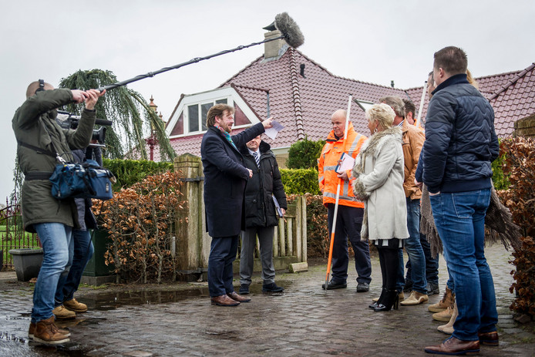
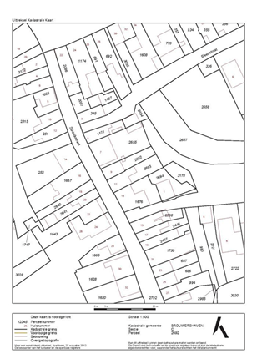
Real world: boundary dispute
Three worlds in practice
Institutional world:
Adverse possession?
Administrative world: Cadastral registration
Reliability of the cadastre in a digital world

Slide 11
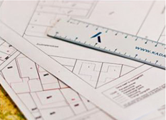
What are the issues?
Cadastral map depicts parcels; Users consider map boundaries as legal boundaries
Boundary information requires setting out
Boundary information is difficult to access (too technical)
Geospatial datasets seem to contradict (within specs) Users experience differences
Reliability of the cadastre in a digital world

Slide 12
Is the perfect cadastral map the solution?
Cadastral map with information on quality and source (information map)
Cadastral map based on accurate geometry (reconstruction map)
Current (index) map Information map Reconstruction map
Reliability of the cadastre in a digital world

Slide 13
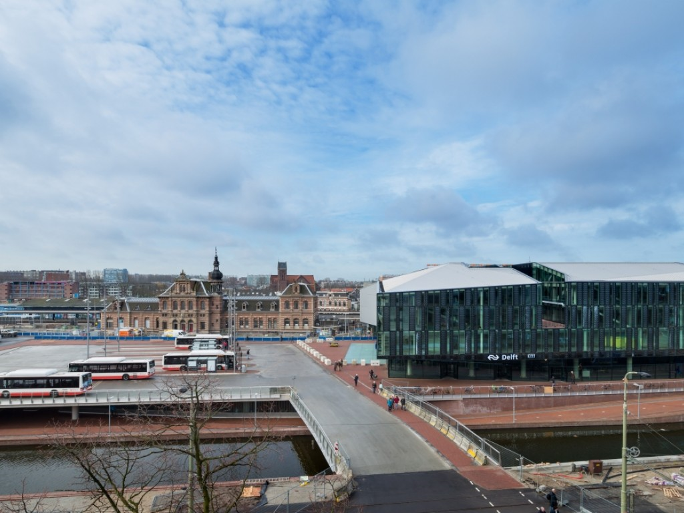
Getting closer to physical reality
Delft railway station - rail infrastructure - railway terminal - offices
Reliability of the cadastre in a digital world

Slide 14
Current solution: 3D-PDF attached to deed;
Increases reliability by providing accessible and usable information Future: 3D-BIM? (as planned or as built?)
Reliability of the cadastre in a digital world

Slide 15
Getting closer to institutional world
Inheritance
Transfer to heirs by law (takes precedence over ‘cadastral owner’)
Decease of ‘cadastral owner’ notified in registration
Encourage registration of succession (free or charge)
Adverse possession
Takes effect by law after a transition period (takes precedence over ‘cadastral owner’)
Public restrictions
In the process of including all restrictions in the registration
Reliability of the cadastre in a digital world

Slide 16
Improvement strategy
Encourage and simplify booking institutional events
life event
rules
institutional fact
causes
results in
Improve currency
institutional event
Improve correspondence
between data and legal facts
Improve usability and
accessibility of data
administrative event
ensures
results in
Better geometric and
semantic correspondence
between administrative data
actor
processes
data
Reliability of the cadastre in a digital world

Slide 17
Concluding remarks
Society increasingly relies on data and assumes cadastral data is correct
Be aware of different perspectives in modelling system
Bring real, administrative and institutional worlds closer together (content and currency)
Thereby increasing trust that will be perceived as better legal reliability
Reliability of the cadastre in a digital world

